Slide 1
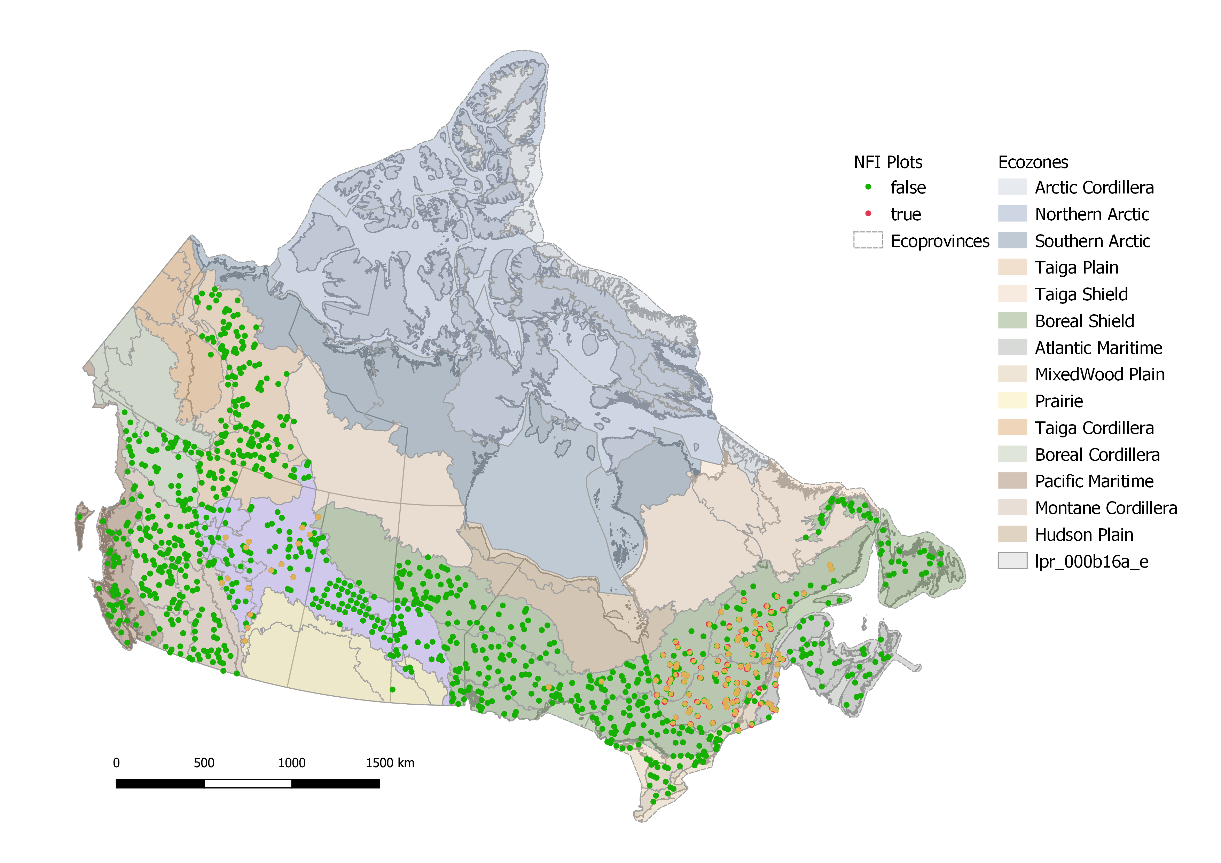
10
7.5
Plots that changed locations
Spatial Analysis
Geodesic distance between locations (km)
5.0
1060 plots total
Based on the unique nfi plot id field of the file gp_all_site_info.csv
2.5
These sites (11.3%)
changed locations on the 2nd campaign
0
Alberta
Quebec
1050
120⁺
1000
950
940
900
850
800
750
700
650
641
Location
600
550
Number of plots
Changed
500
Unchanged
450
400
350
300
250
200
150
100
50
55
0
There are four important variables relating to each plot:
loc_id = if a given plot changed locations i.e., due to new danger to sampling or other reason
meas_num = how many times a plot has been measured
plot_completeness = if all parameters were measured or not
meas_date = when the sampling happened
0
1
2
Measurement number*
* A newly established plot will have measurement number ‘0’.
First re-measurement would be ‘1’, second ‘2’ etc.
⁺ There is no measurement for when nfi_plot 1074436 was established

Slide 2
meas_num | Location change | Full (F) | Partial (P) | Not repor. (N) | Incomplete (U)
0 | Changed | 104 | 16 | 119 | -
0 | No change | 211 | 47 | 681 | 1
1 | No change | 600 | 25 | 15 | 1
2 | No change | 53 | 2 | 0 | 0
NFI plots
Summary sites
Location changes
* A newly established plot will have measurement number = 0. First re-measurement would be 1, etc.
Completeness
1050
1000
950
900
850
800
750
Completeness
700
650
Full
600
Partial
550
Number of plots
Not reported
500
Incomplete
450
400
350
300
250
200
150
100
50
0
0
1
2
Measurement number

Slide 3
meas_num | Location change | Full (F) | Partial (P) | Not repor. (N) | Incomplete (U)
0 | Changed | 104 | 16 | 119 | -
0 | No change | 211 | 47 | 681 | 1
1 | No change | 600 | 25 | 15 | 1
2 | No change | 53 | 2 | 0 | 0
NFI plots
Summary sites
Location changes
* A newly established plot will have measurement number = 0. First re-measurement would be 1, etc.
Completeness
1050
1000
950
900
850
800
The long horizontal lines are mostly Quebec.
They all contain the following comment:
750
Completeness
700
QC_MRNF-PSPConverted
650
Full
I think this means it was converted from a Permanent Sample Plot from the le ministre des Ressources naturelles et de la Faune (MRFN) to a NFI plot
600
Partial
550
Number of plots
Not reported
500
Incomplete
https://www.ncbi.nlm.nih.gov/pmc/articles/PMC8234928/#ref-50
https://mffp.gouv.qc.ca/documents/forets/inventaire/Norme_inventaire_PIEN.pdf
450
400
350
300
250
200
150
100
50
0
0
1
2
Measurement number
Partially complete’ and ‘Not reported’ have these variables with similar missing patterns
Plotbio_lgshrub_live
Plotbio_lgshrub_dead
Plotbio_smshrub
Plotbio_bryo

Slide 4
Location Change
Completeness
Other features
Time span between measurements
Changed
Incomplete
Converted plot
1-2
Measurement pair
Unchanged
Complete
0-1
2.5
5
7.5
10
12.5
15
Years

Slide 5
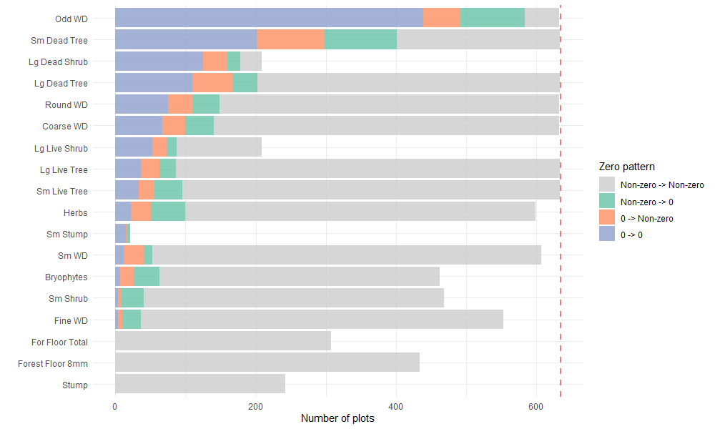
Are zero also used as NAs?
STr-Sh-Stp plot
Eco plots
Lg tree plot
Microplot
Transect
Why are there variables with mostly zeros e.g. herbs, and some with mostly NAs
e.g. Lg Live Shrub?
Non-zero to Non-zero
Non-zero -> 0
0 -> Non-zero
0 -> 0
11.28m
10m
5.64m
3.99m
Relevant files:
NA > ~10%
High 0 Low NA
Empty spaces mean NA
Total of 634 plots with
before and after measurements
NA < ~10%
Low 0 High NA
zero_patterns_nas.csv

Slide 6
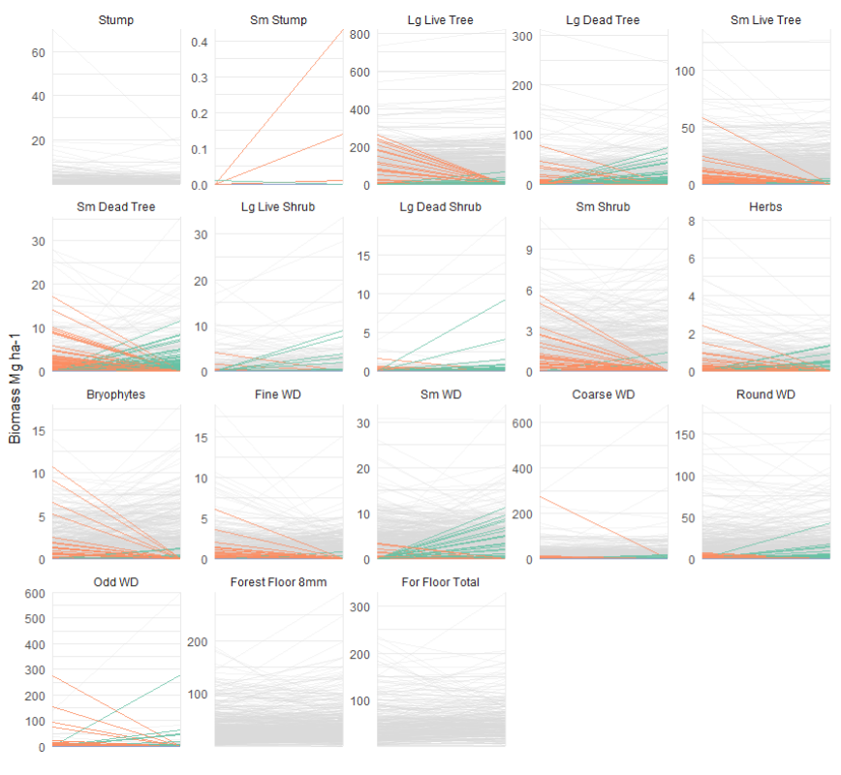
Any large discrepancies on zero patterns?
0 -> Non zero
Non zero -> 0
Before
After
Disturbance
5
10
15
N years between measurements

Slide 7
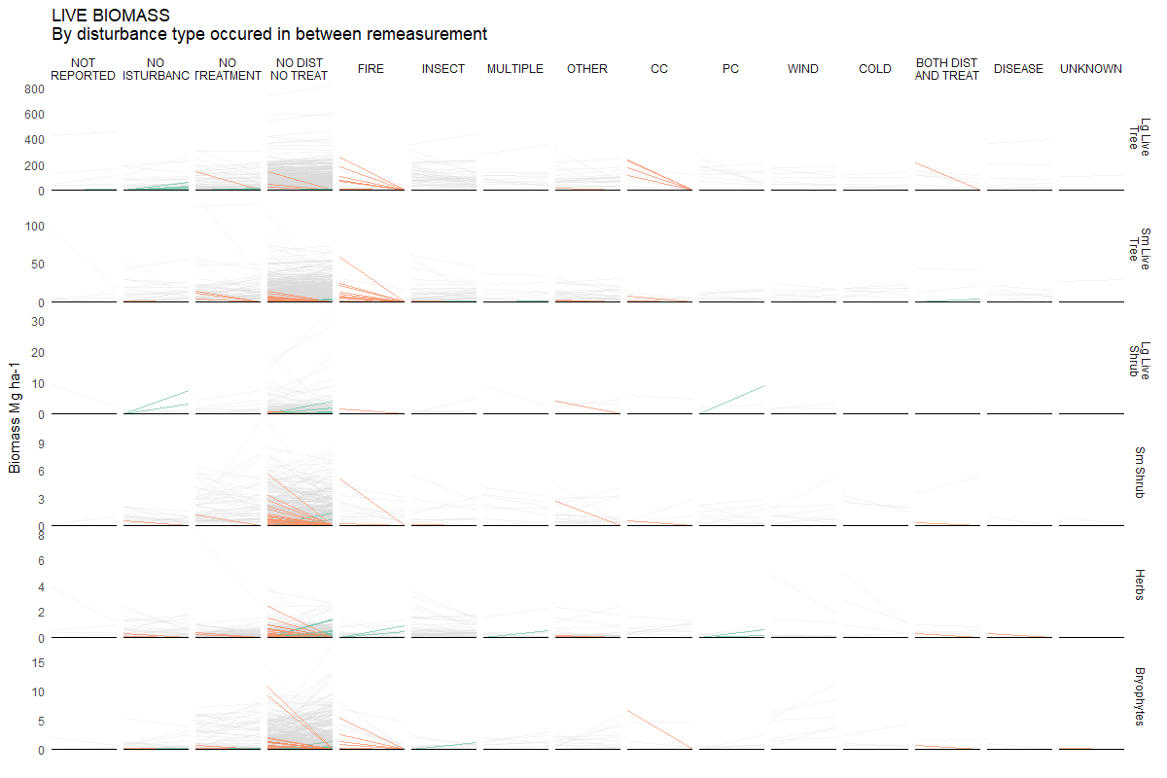
0 -> Non zero
Non zero -> 0
Before
After
Disturbance
5
10
15
N years between measurements
LIVE BIOMASS
REMEASUREMENT
INFO
Relevant files:
zero_pattern_lines_live.csv

Slide 8
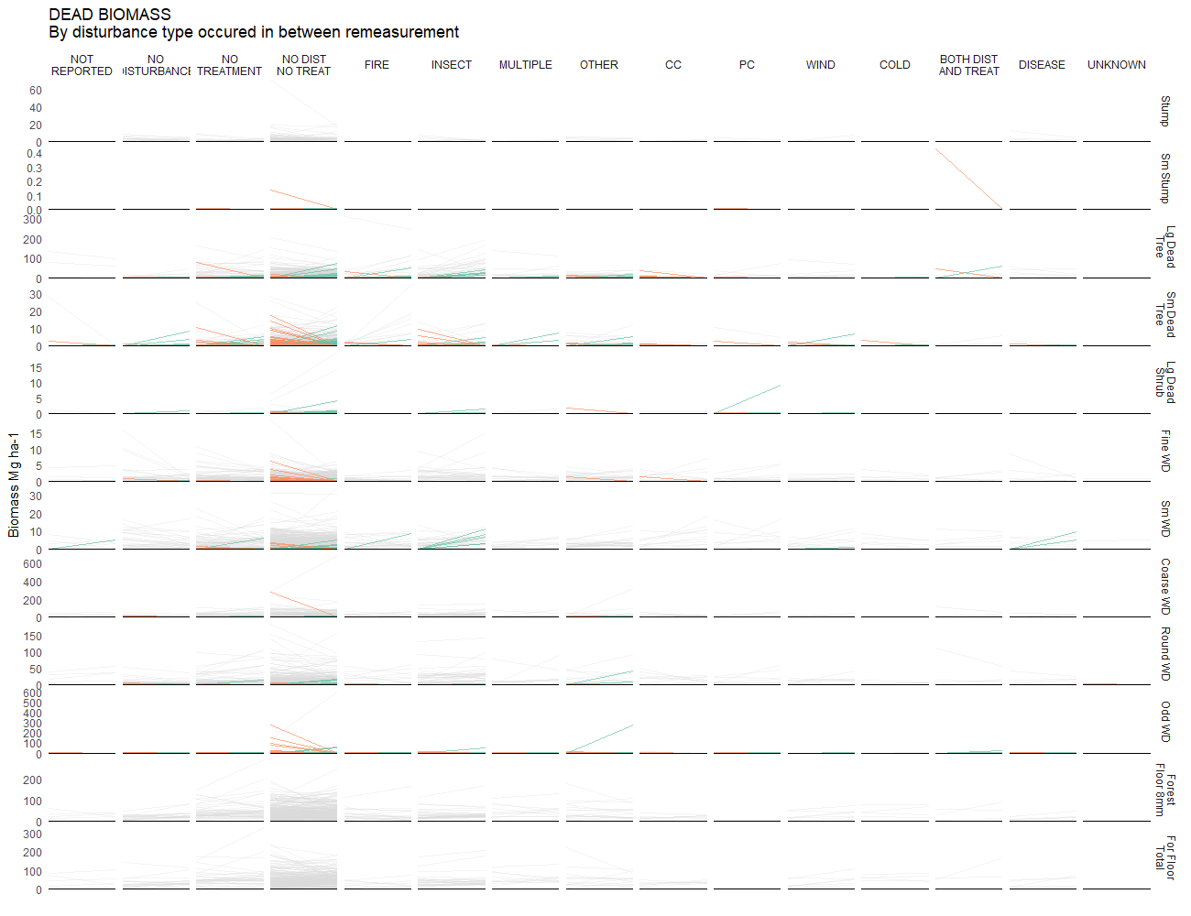
0 -> Non zero
Non zero -> 0
Before
After
Disturbance
5
10
15
N years between measurements
DEAD BIOMASS
REMEASUREMENT
INFO
Relevant files:
zero_pattern_lines_dead.csv

Slide 9
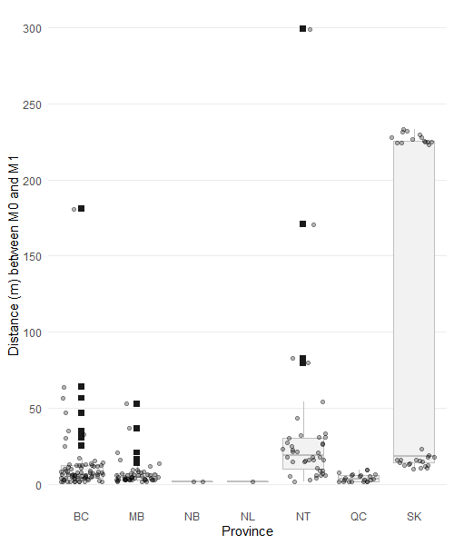
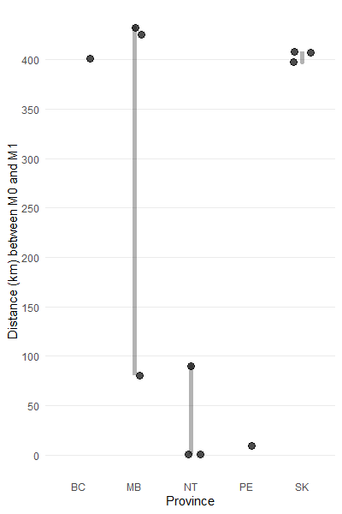
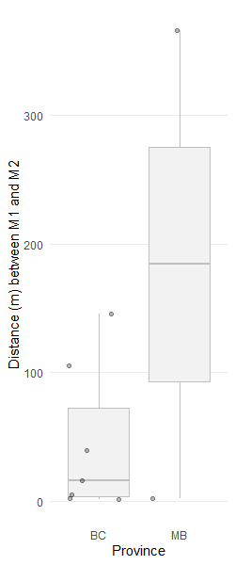
Errors in GPS positions
Sites with loc_id = 0
Total different than 0 = 288
Between 2m and 300m apart
Above 300m
N = 220
N = 11
N = 9
KM distance
Relevant files:
loc_unchanged_geodist.csv
above300m_loc_diff.csv

